Slide 1
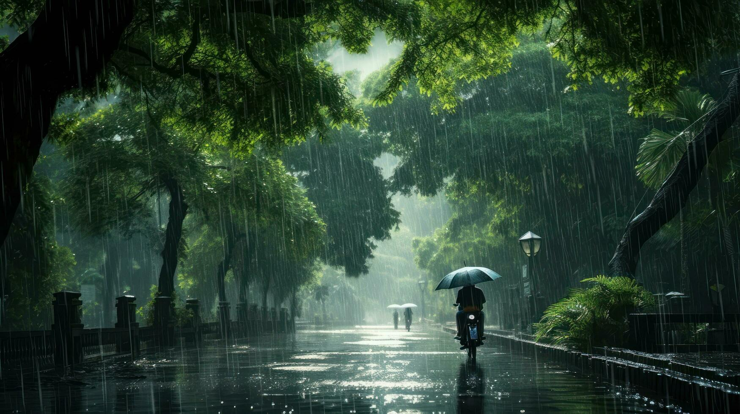
Rainy Season
A little rain can wash away worries and bring fresh ideas. A rainy day is a perfect excuse to share smiles and laughter with friends.

